Slide 1

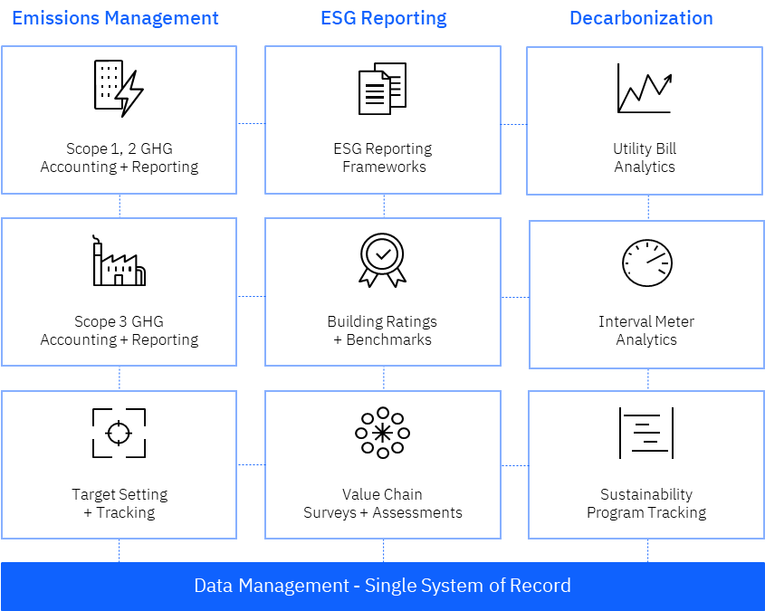



Envizi – an IBM Company
1.
What is Envizi?
2.
Why now?
3.
Key challenges
4.
Value proposition
Envizi offers comprehensive data and analytics software to collect, manage and derive insights from sustainability data.
Our clients use Envizi to:
Create a finance-grade, single system of record for their sustainability data.
Manage Greenhouse Gas (GHG) emissions accounting.
Support Environmental Social & Governance (ESG) reporting.
Deliver insights to underpin decarbonization strategies.
Investors: Investment in ESG
assets may reach $53 trillion
by 2025, representing over 1/3rd
of Global Assets Under Management
Complexity: Sustainablity initiatives cut across business operations. It’s difficult to know where to start.
Envizi's solutions simplify the consolidation, analysis, and management of siloed data sources to meet sustainability reporting frameworks requirements , manage stakeholders, and meet sustainability goals
Consumers: 80% of consumers indicate sustainability is important to them and are looking to organizations to make corporate commitments such as Net Zero.
Growing number of stakeholders to Manage: Investors, Consumers, Employees, and Governments
Build a Data Foundation
Streamline Reporting + Disclosure
Accelerate decarbonization
Employees: 64% of millennials
consider a company’s social
and environmental commitments
when deciding where to work
Mounting pressure to progress toward more sustainable
and socially responsible business operations
A single system of record that delivers auditable, financial grade sustainability data across key ESG data points and metrics.
GHG calculation and flexible reporting tools to meet internal and external reporting requirements and frameworks.
Unlock insights to inform the fastest and most cost-effective pathway to low carbon goals
Governments: 38 of the world’s top
50 economies have or are developing, corporate disclosure requirements
around environmental impact
Managing and operationalizing sustainability data across siloed sources and evolving
reporting datasets
Delivered as an easy
to adopt SaaS solution
5.
Solution framework
6.
Markets- where to focus
7.
User personas
9.
Competitive landscape
Sustainability Manager
Energy Manager
Real Estate Manager
Facility Manager
(engineering, facilities, ops management)
Sustainability and ESG specialists: Measurabl, Conservice, UL360, Figbytes,
Persefoni, OneTrust
Commercial Real Estate
Environmental Health & Safety:
Sphera, Enablon, CR360, and Cority
Energy:
Schneider Electric, EnergyCap
ERP:
Salesforce
Financial Services
Banks
Venture Capital and PE
8.
Target buyers
10.
Adoption
Telecommunications
Chief Sustainability Officer
Chief Corporate Affairs
Chief Financial Officer
Chief Operating Officer
Environmental Affairs
150
7B+
Enterprise Clients
Records uploaded annually
And more…
152
690K
Government
Healthcare
Education
Countries
Utility Accounts
79K
Utility Meters
January 2023

